Slide 1


The effect of Laser Noise on Rabi Oscillations
Xiaoyu Jiang
University of Wisconsin-Madison
2020/06/24

Slide 2

Overview
Motivations for the QISE-NET project
Current work---Effect of Laser noise on Rabi Oscillations
Future plans

Slide 3
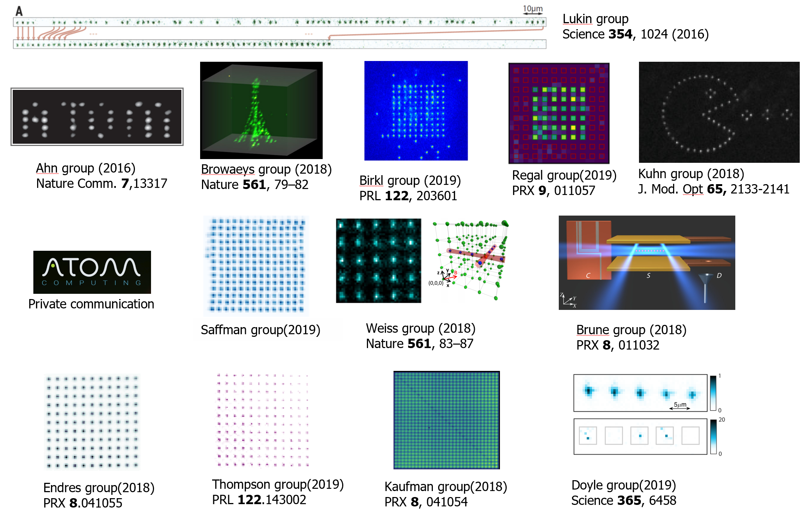
1. Motivations for the QISE-NET project
Atomic Arrays for Quantum Computing/Simulations

Slide 4
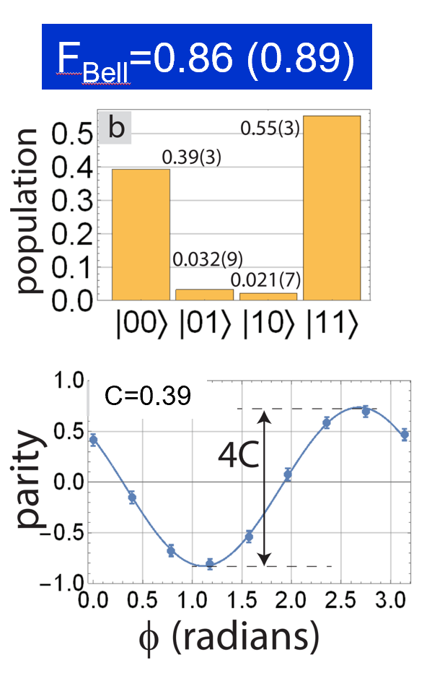
Challenges for our Atomic Array
arXiv:1908.06103
The major error contributions comes from:
1) Finite temperature causing Doppler dephasing.
2) Finite temperature causing atom position
variation
3) Laser noise
Motivation: Model and simulate the sources of error in our experiments to help us better understand the physics of the errors and improve our experiment results

Slide 5
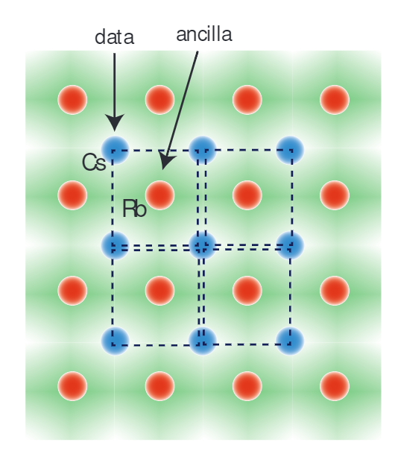
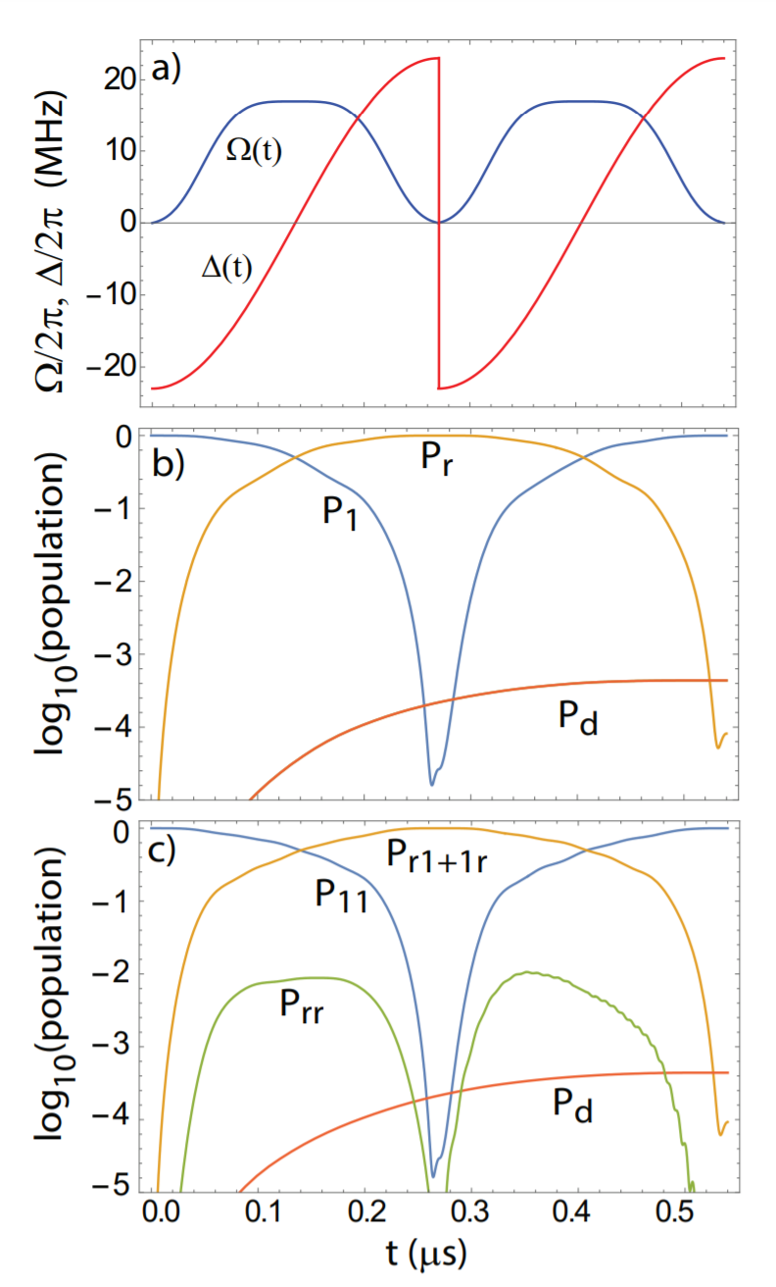
New gate protocols/algorithms
CZ gate with ARP pulses.
arXiv: 1912.02977
Two species surface code
Motivation: Model and simulate the performance of new gate protocols and algorithms

Slide 6
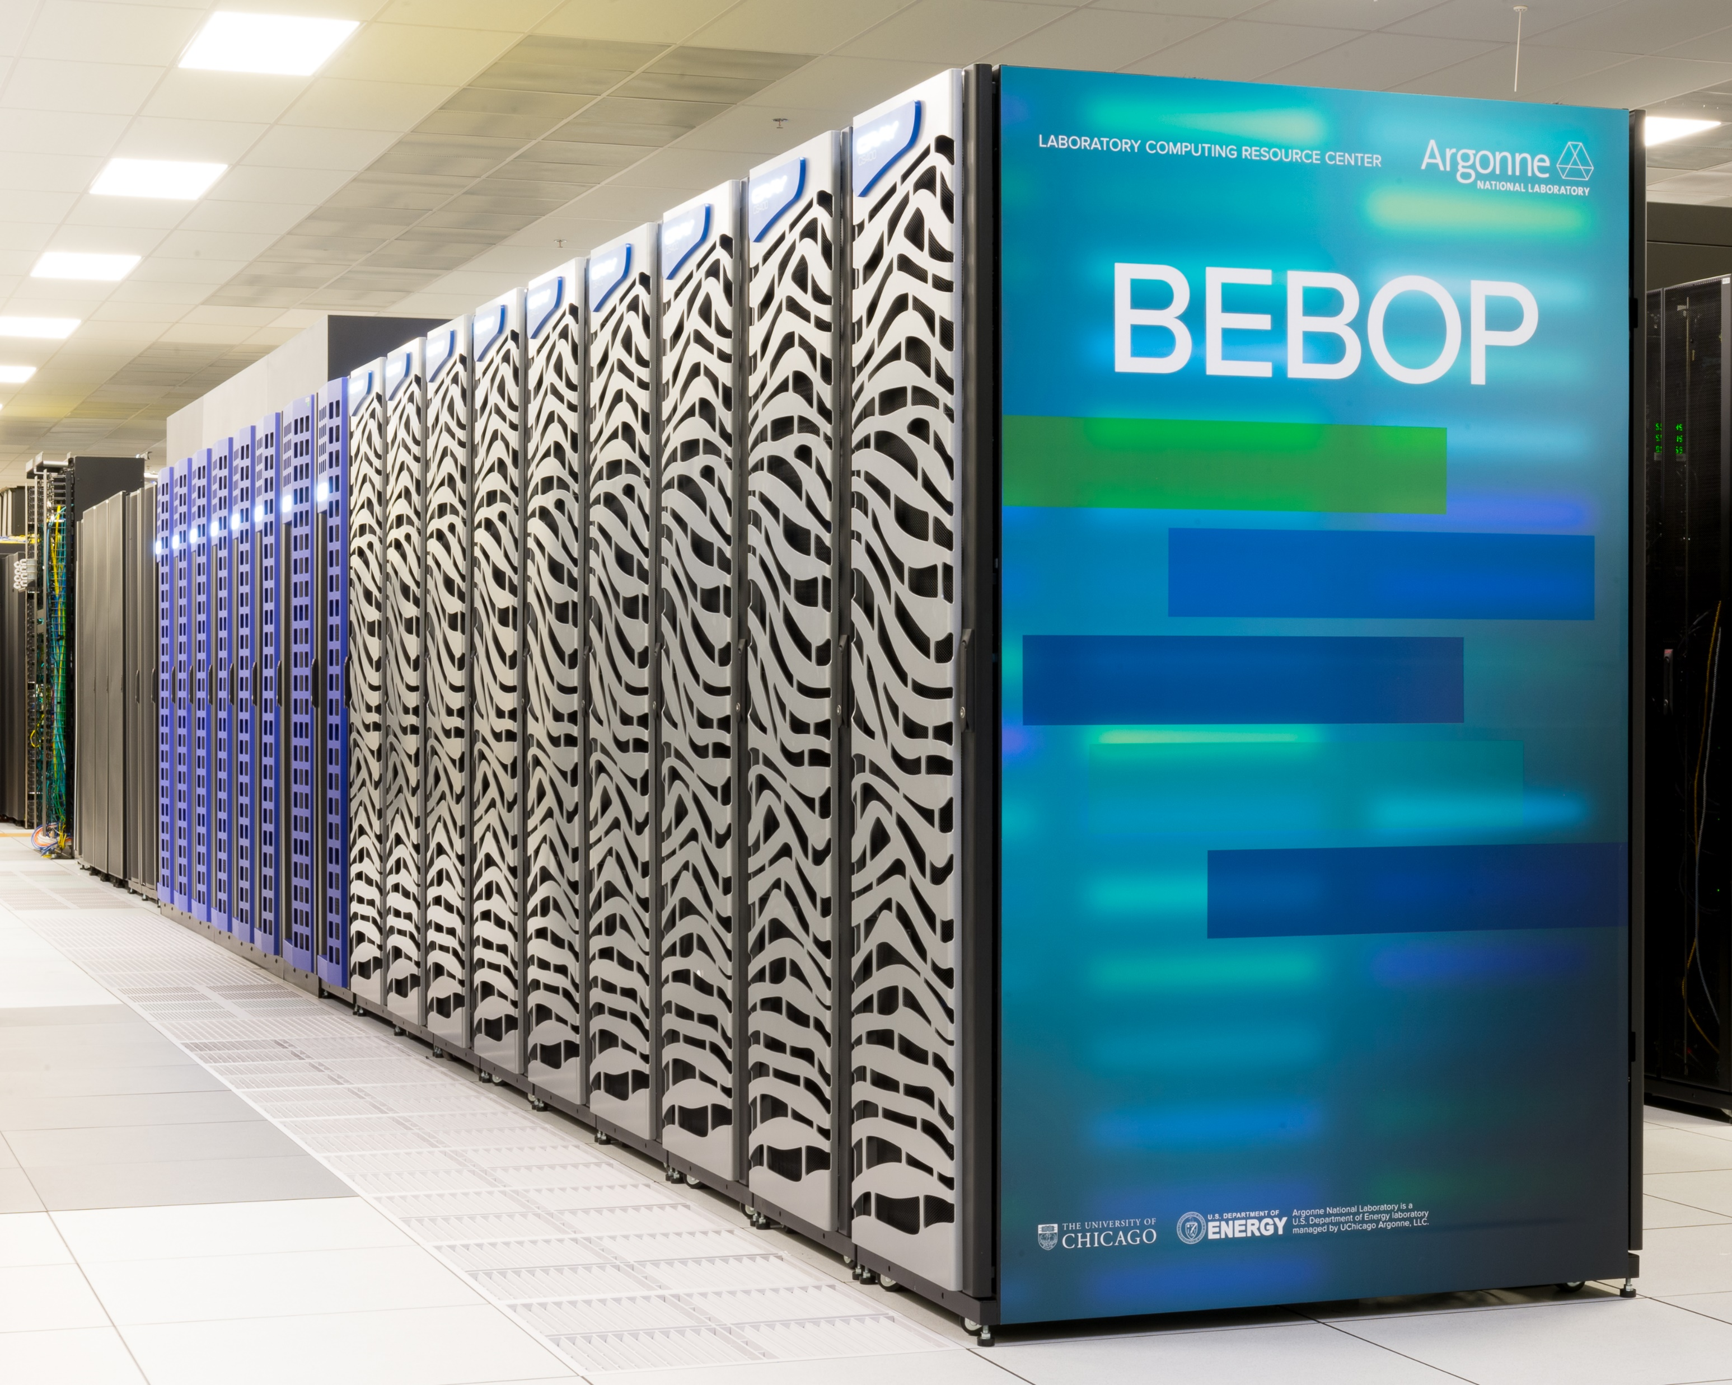
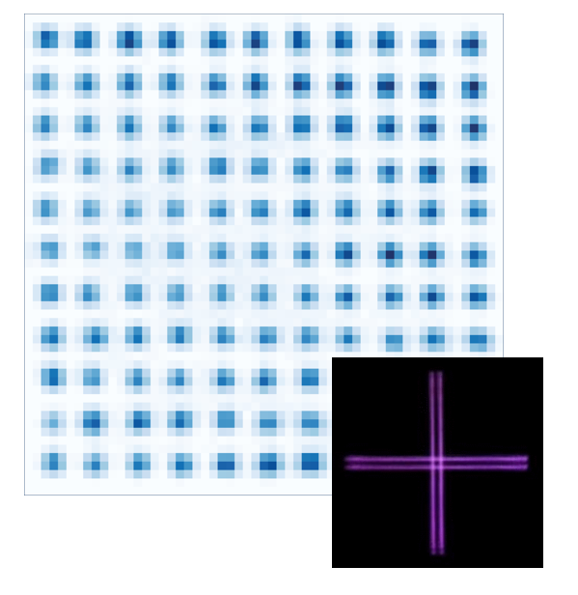
Motivations for the QISE-NET project
Resource and expertise in computing at Argonne National Laboratory
Scalable 2D atomic array
experiment

Slide 7
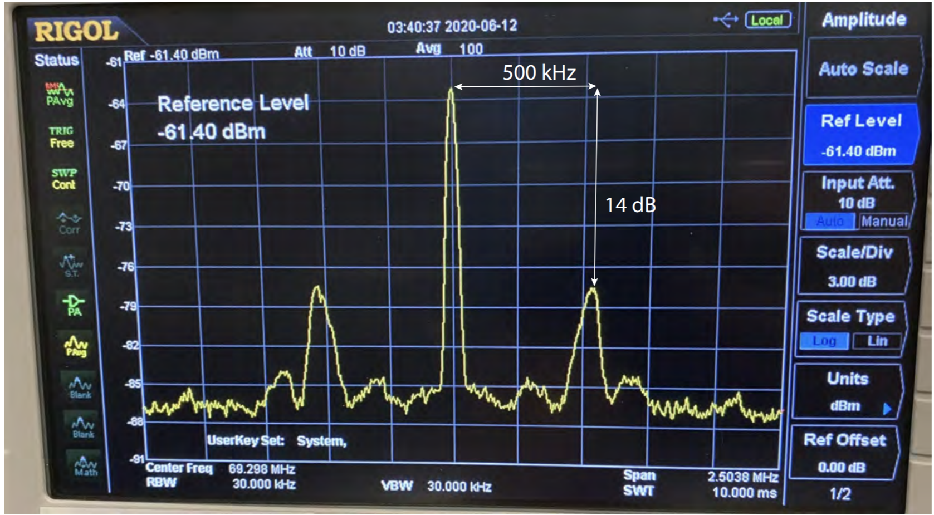
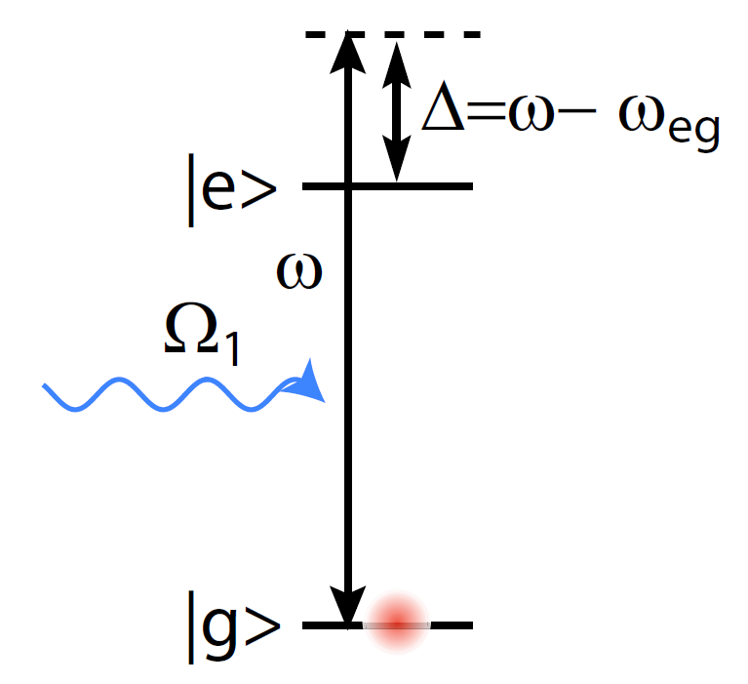
2. Effect of Laser noise on Rabi Oscillations
Laser noise: Intensity Noise + Phase/Frequency Noise
Perfect laser: δ-function lineshape
Reality: Self-heterodyne measurements of a locked laser’s lineshape.
Finite Linewidth + Servo bumps
Approach:
Numerical Simulation + Quasi-Static Modeling

Slide 8
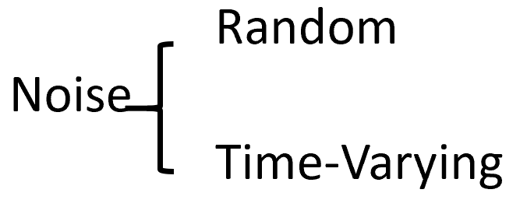
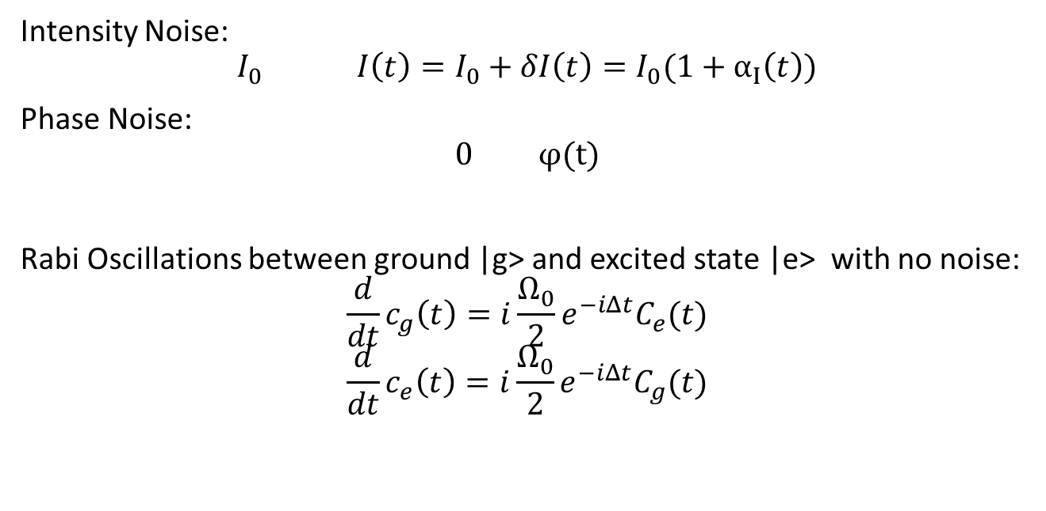
Numerical Simulations for Laser Noise
Model noise as Gaussian Processses
Intensity Noise:
$$I_{0} I\left(t\right)=I_{0}+δI\left(t\right)=I_{0}(1+α_{Ι}\left(t\right))$$
Phase Noise:
$$0 φ(t)$$
Rabi Oscillations between ground |g> and excited state |e> with no noise:
$$\frac{d}{dt}c_{g}\left(t\right)=i\frac{Ω_{0}}{2}e^{−iΔt}C_{e}(t)$$
$$\frac{d}{dt}c_{e}\left(t\right)=i\frac{Ω_{0}}{2}e^{−iΔt}C_{g}(t)$$

Slide 9
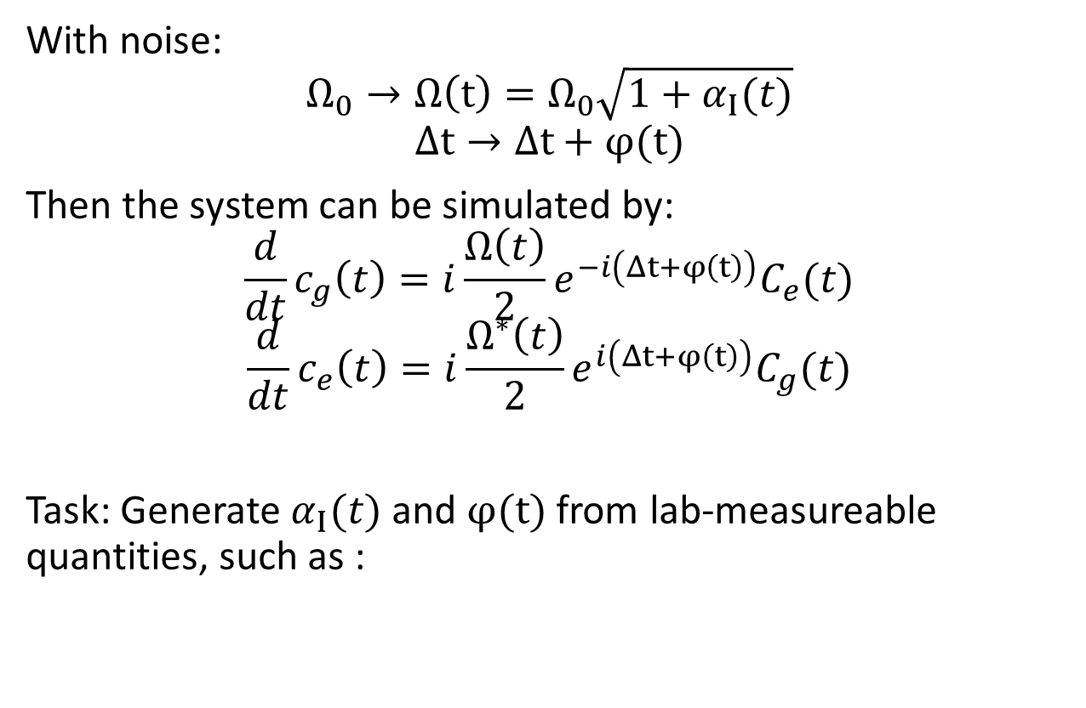
Numerical Simulations for Laser Noise
With noise:
$$Ω_{0}→Ω\left(t\right)=Ω_{0}\sqrt{1+α_{Ι}(t)}$$
$$Δt→Δt+φ(t)$$
Then the system can be simulated by:
$$\frac{d}{dt}c_{g}\left(t\right)=i\frac{Ω\left(t\right)}{2}e^{−i\left(Δt+φ\left(t\right)\right)}C_{e}(t)$$
$$\frac{d}{dt}c_{e}\left(t\right)=i\frac{Ω^{∗}\left(t\right)}{2}e^{i\left(Δt+φ\left(t\right)\right)}C_{g}(t)$$
Task: Generate $α_{Ι}(t)$ and $φ(t)$ from lab-measureable quantities, such as :

Slide 10
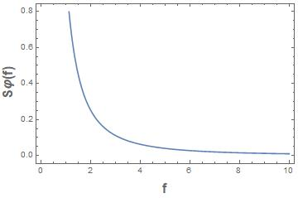
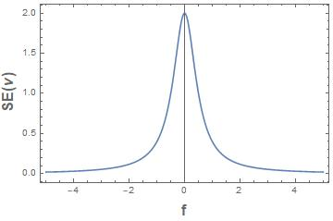
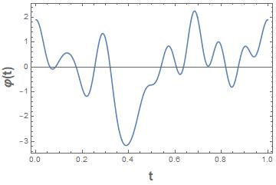
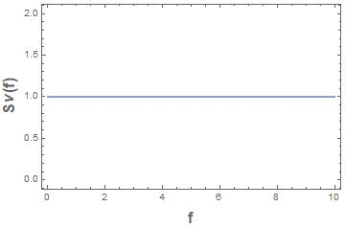
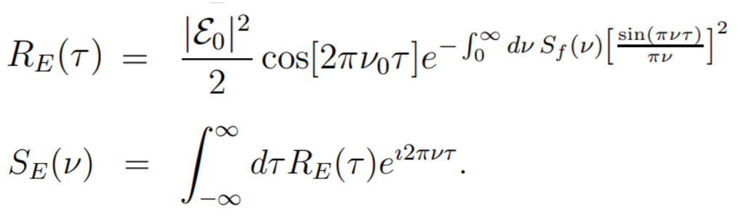
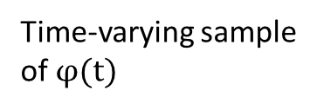
Example: frequency noise
①
②
Linewidth Spectrum
(Example: Lorentzian Lineshape)
Time-varying sample of $φ(t)$
Noise Spectrum for phase(above) and
frequency (below) noise
For more complicated lineshapes:
② Always possible using sample-path generation technique
① Not always possible, relies on the following expression:

Slide 11
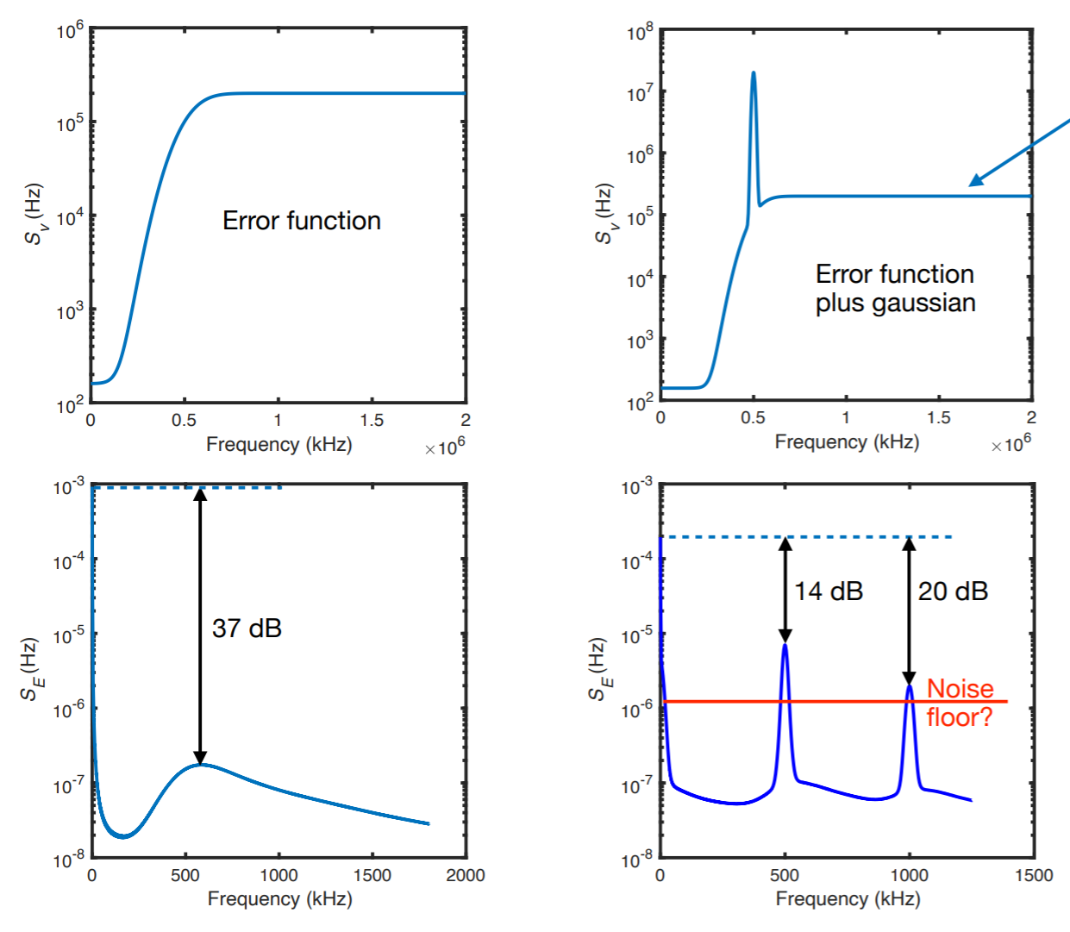
Servo-bump Modeling
Alternate solution:
Find frequency noise spectrums that will give similar structures to lab measurements:

Slide 12
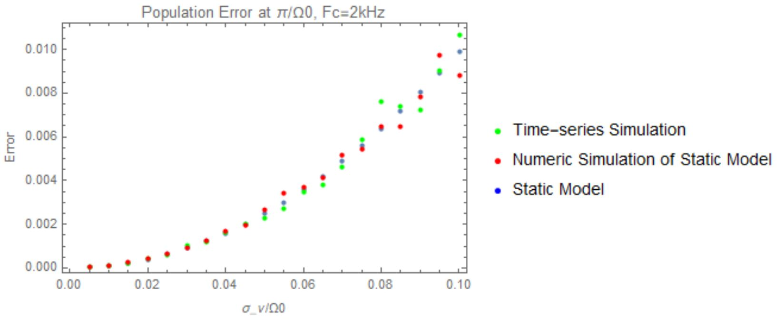
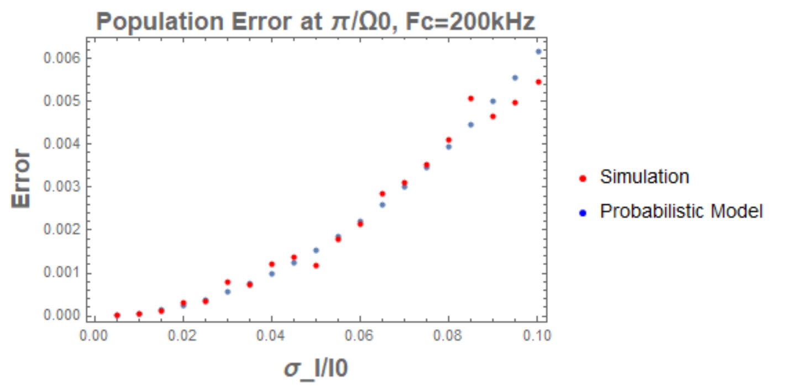
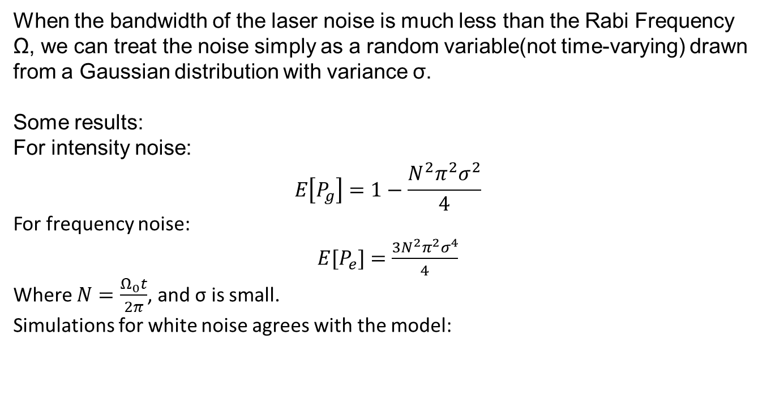
Quasi-Static models
When the bandwidth of the laser noise is much less than the Rabi Frequency Ω, we can treat the noise simply as a random variable(not time-varying) drawn from a Gaussian distribution with variance σ.
Some results:
For intensity noise:
$$E\left[P_{g}\right]=1−\frac{N^{2}π^{2}σ^{2}}{4}$$
For frequency noise:
$E[P_{e}]=$ $\frac{{3N}^{2}π^{2}σ^{4}}{4}$
Where $N=\frac{Ω_{0}t}{2π}$, and σ is small.
Simulations for white noise agrees with the model:

Slide 13
Next steps on Laser Noise
Servo bump modeling
Coherence simulation/modeling
Two photon Rabi simulation
Compare lab measurements with our outcomes

Slide 14
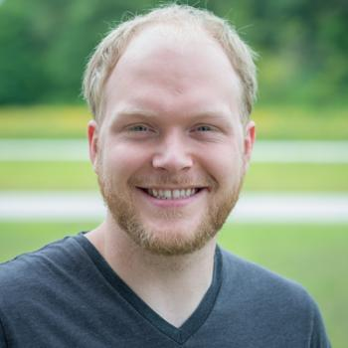
Future Plans: Collaboraton with ANL
Currently doing Research-Aide internship in Argonne (06/15-08/21)
Two species surface code
Matt Otten
Advantages:
Scalable and reconfigurable atom arrays
Dual species eliminates inter-species crosstalk

Slide 15
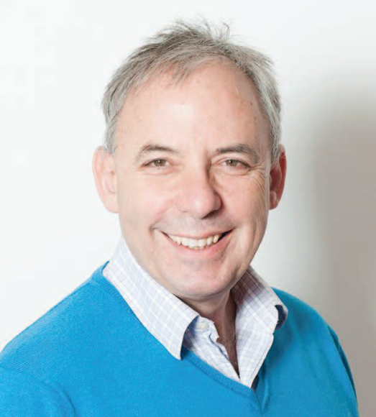
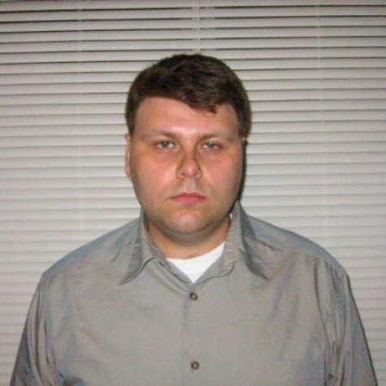
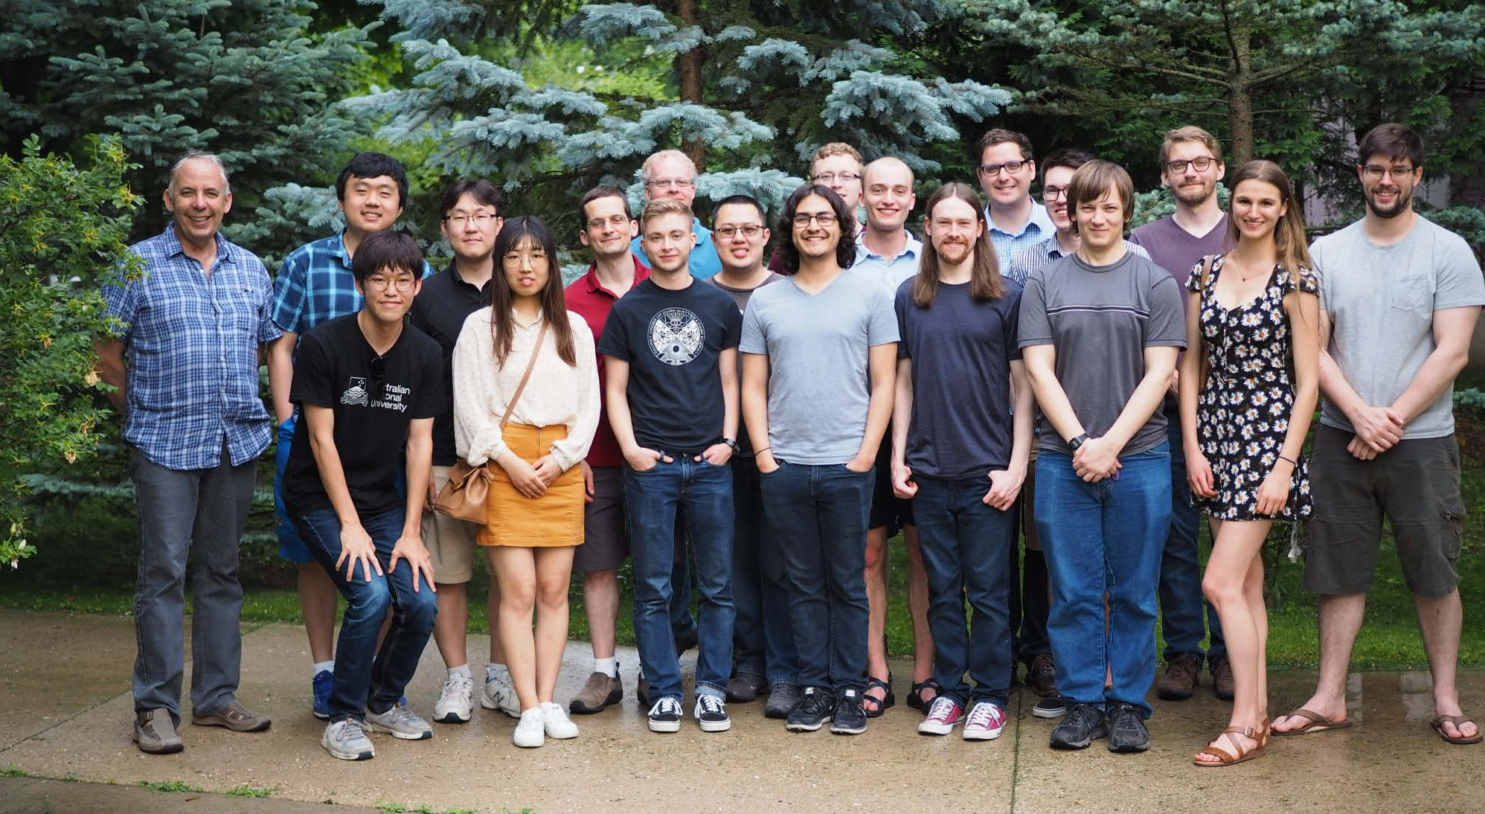
Acknowledgements:
Mark Saffman
Yuri Alexeev

